Slide 1
Boosting Algorithms AdaBoost XgBoost LightGradientBoost
Deepa D

Slide 2
Ada Boost Algorithm
The principle behind boosting algorithms is that we first build a model on the training dataset and then build a second model to rectify the errors present in the first model.
This procedure is continued until and unless the errors are minimized, and the dataset is predicted correctly.
Boosting algorithms work in a similar way, it combines multiple models (weak learners) to reach the final output (strong learners).

Slide 3
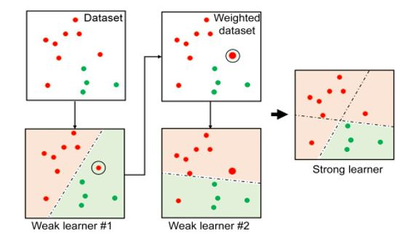
Combining weak learners, assigning weights to incorrect values and creating strong model

Slide 4
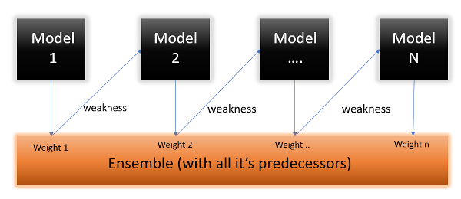
AdaBoost, short for Adaptive Boosting, is an ensemble learning method that combines multiple weak learners to form a stronger, more accurate model.

Slide 5
Advantages of adaboost algorithm
High Accuracy
Feature Selection
Simple to Implement
Fewer Parameters to Tune
Can Be Parallelized

Slide 6
Disdvantages of adaboost algorithm
Requires Sufficient Training Data
Computationally Intensive
Not Suitable for Regression Tasks
Vulnerable to Bias

Slide 7
Applications of AdaBoost algorithm
Face Detection
Object Detection
Text Categorization
Medical Diagnosis
Financial Fraud Detection
Anomaly Detection

Slide 8
XG(Extreme Gradient)Boost Algorithm
Extreme Gradient Boosting Algorithm is an advanced version of gradient boosting algorithm.
Implements gradient boost decision trees.
Used by data scientist and researchers worldwide to optimize their machine learning models.
Trains and test on large amount of data’s.
XGBoost is a versatile and powerful algorithm that excels in both regression and classification

Slide 9
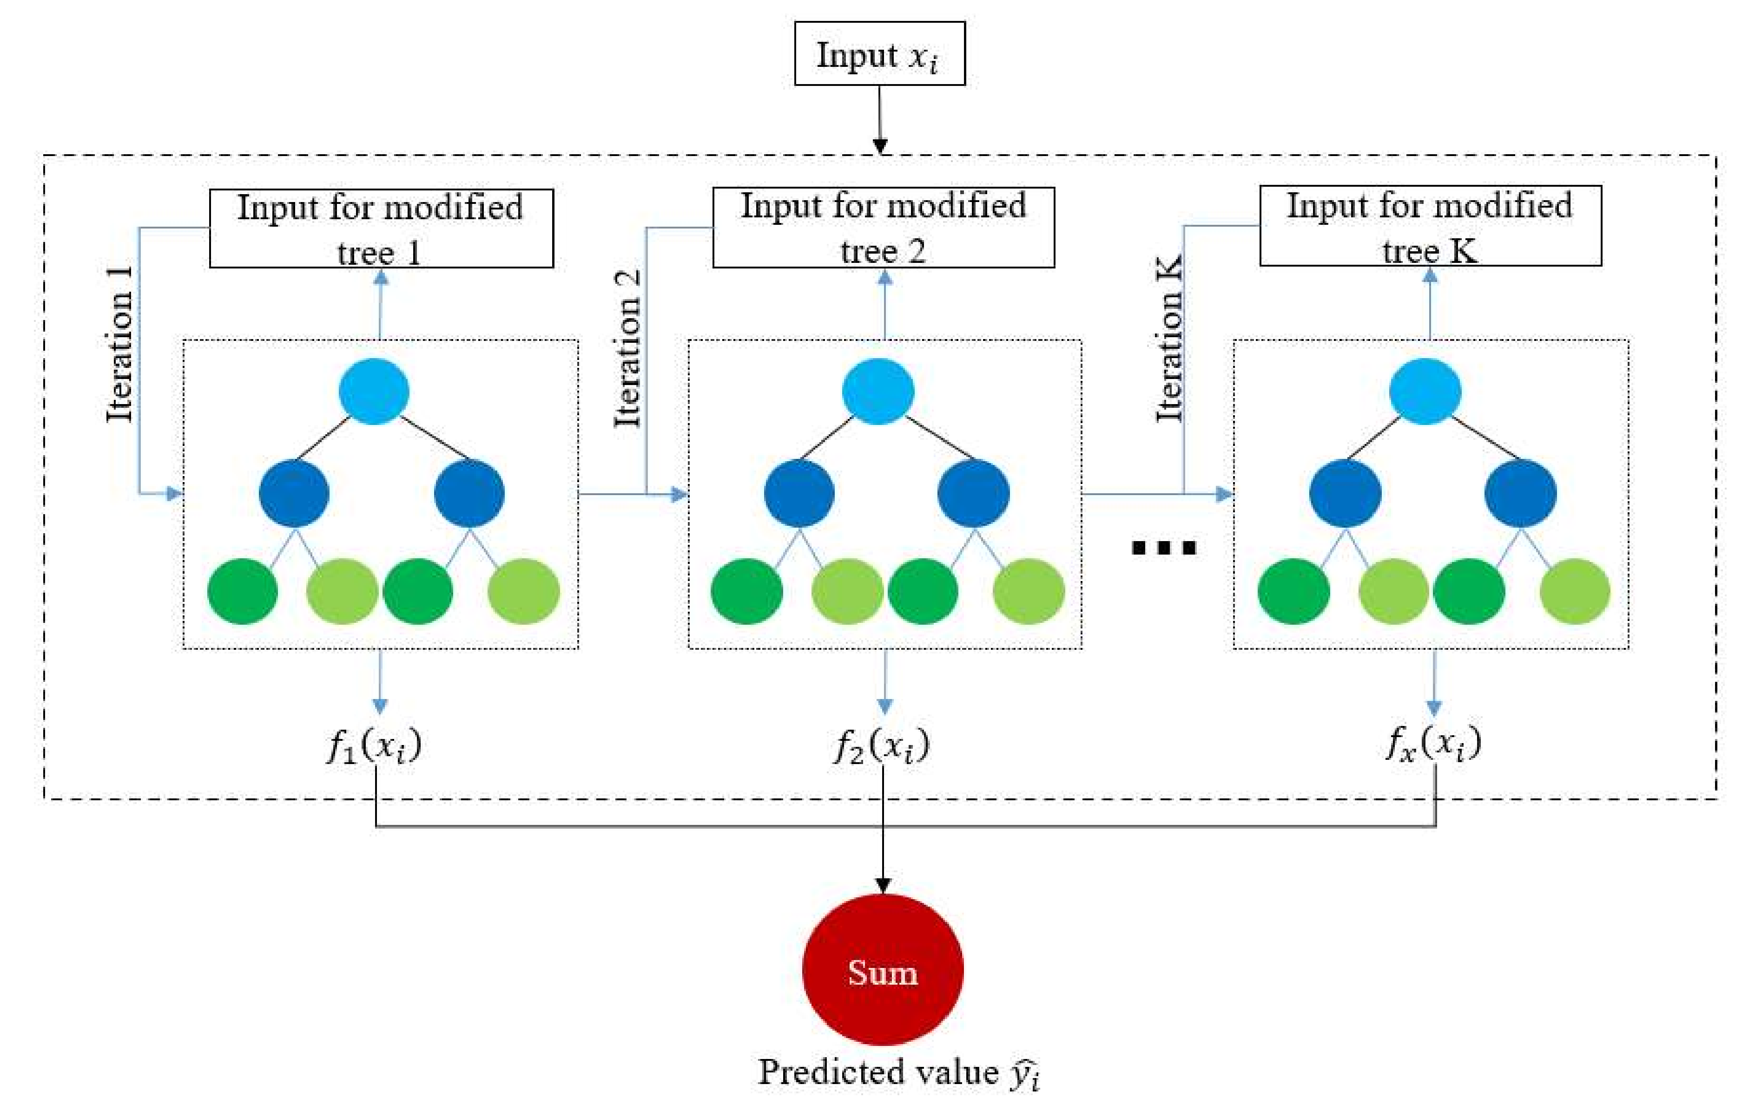
XG(Extreme Gradient) Boost Algorithm

Slide 10
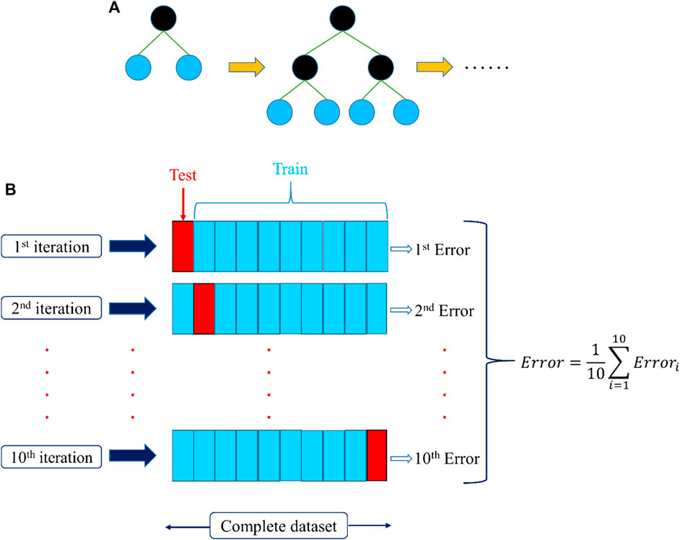
XG(Extreme Gradient) Boost Algorithm

Slide 11
Advantages: XG(Extreme Gradient)Boost Algorithm
High Performance
Scalability
Ensemble Learning
Cross-Validation.
Wide Adoption and Support

Slide 12
Disadvantages: XG(Extreme Gradient)Boost Algorithm
Computational complexity
Overfitting on smaller data sets
Hypertuning parameter adjustment is difficult to optimize
Memory requirements are high when working with larger datasets

Slide 13
Applications: XG(Extreme Gradient)Boost Algorithm
Classification
Regression
Ranking
Time Series Forecasting
Customer Segmentation
Image Analysis

Slide 14
Light GBM
LightBGM is a decision tree structure representing leaf node splits containing predictions.
Light BGM trees are constructed recursively in a leaf-wise manner, focusing on maximizing the reduction in loss at each step during training.
In each split it tries to optimize a specific objective function
Predictions are made by aggregating the outputs of individual trees, resulting in accurate and efficient machine learning models.
It tends to perform well in large scale data sets.

Slide 15
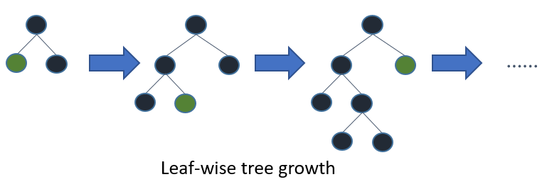
Light GBM

Slide 16
Advantages of Light GBM
High Performance
Lightweight and Memory Efficient
Handling Categorical Variables
Parallel and GPU Learning
Regularization
Handling Missing Values

Slide 17
Disadvantages of Light GBM
Sensitivity to Hyperparameters
Complex Model
Data Size Limitations
Imbalanced Data Handling
Limited Documentation and Support

Slide 18
Applications of Light GBM
Recommendation Systems
Financial Modeling
Healthcare Analytics
Fraud detection
Natural Language Processing (NLP)
Time Series Forecasting
Image Recognition and Computer Vision

